Slide 1

Position of the data-link layer

Slide 2

Chapter 10
Error Detection
and
Correction

Slide 3

Error Detection and Correction
Note
Data can be corrupted during transmission.
  Some applications require that errors be detected
  and corrected.
Error Detection and Correction are implemented
at the data link layer and the transport layer of the
internet model

Slide 4
10.1 INTRODUCTION
Let us first discuss some issues related, directly or indirectly, to error detection and correction.
Topics discussed in this section:
Types of Errors
Redundancy
Detection Versus Correction
Forward Error Correction Versus Retransmission
Coding
Modular Arithmetic

Slide 5
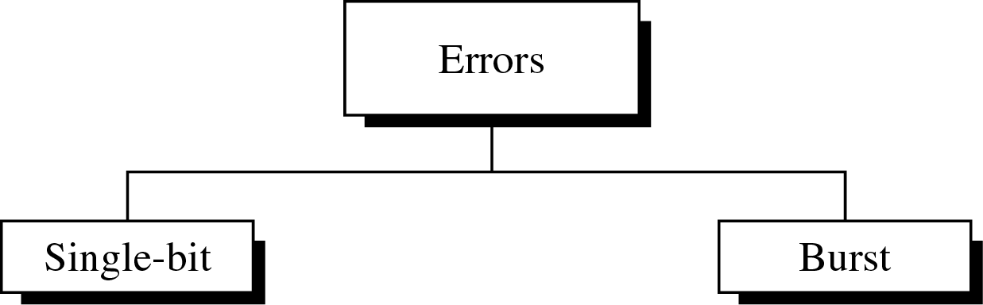
10.1 Type of Errors

Slide 6
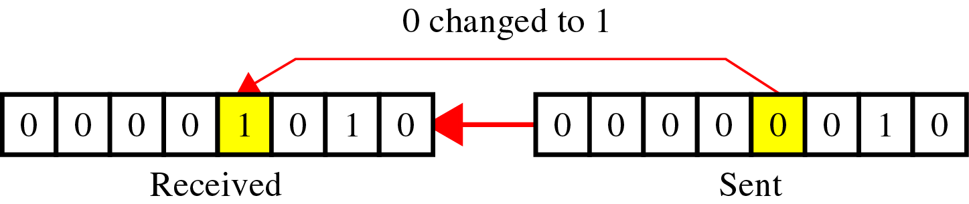
Type of Errors(cont’d)
Single-Bit Error
In a single-bit error, only 1 bit in the data unit has
changed.

Slide 7

Type of Errors(cont’d)
Burst-Bit Error
  A burst error means that 2 or more bits in the data unit
have changed.
The length of the burst is measured from the 1st corrupted bit to the last corrupted bit.
  Some bits in between may not have been corrupted.

Slide 8
Redundancy
The central concept in detecting or correcting errors is Redundancy.
Instead of repeating the entire data stream, a shorter group of bits may be appended to the end of each unit. → This technique is called Redundancy.
  These extra bits are discarded as soon as the accuracy of the transmission has been determined.
To detect or correct errors, we need to send extra (redundant) bits with data.

Slide 9
Error Detection Vs Correction
Error detection
  looking only to see if any error has occurred.
Error correction
  Need to know the exact number of bits that are corrupted and more importantly, their location in the message.
The correction of errors is more difficult than the detection.

Slide 10
Forward Error Correction Vs Retransmission
Forward Error Correction
  is the process in which the receiver tries to guess the message by using redundant bits.
Retransmission
  is a technique in which the receiver detects the occurrence of an error and asks the sender to resend the message.

Slide 11
Coding
Redundancy is achieved through various coding schemes.
  Coding schemes : Block coding and Convolution coding.
The sender adds redundant bits through a process that creates a relationship between redundant bits and the actual data bits.
The receiver checks the relationships between the two sets of bits to detect or correct the errors.

Slide 12

Coding
Figure 10.3 The structure of encoder and decoder
In this book, we concentrate on block codes; we leave convolution codes
to advanced texts.

Slide 13
Modular Arithmetic
In modulo-N arithmetic, we use only the integers in the range 0 to N −1, inclusive.
We define an upper limit, called a Modulus N.
We then use only the integers 0 to N −1, inclusive.

Slide 14

Modulo-2 Arithmetic
Adding 0+0=0 0+1=1 1+0=1 1+1=0
Subtracting 0-0=0 0-1=1 1-0=1 1-1=0
Figure 10.4 XORing of two single bits or two words

Slide 15
10.2 BLOCK CODING
In block coding, we divide our message into blocks, each of k bits, called datawords. We add r redundant bits to each block to make the length n = k + r. The resulting n-bit blocks are called codewords.
Topics discussed in this section:
Error Detection
Error Correction
Hamming Distance
Minimum Hamming Distance

Slide 16

Block Coding
Figure 10.5 Datawords and codewords in block coding

Slide 17
Block Coding
Example 10.1
The 4B/5B block coding discussed in Chapter 4 is a good example of this type of coding. In this coding scheme,
k = 4 and n = 5. As we saw, we have 2^{k} = 16 datawords and 2^{n} = 32 codewords. We saw that 16 out of 32 codewords are used for message transfer and the rest are either used for other purposes or unused.

Slide 18

BLOCK CODING - Error detection
If the following two conditions are met, the receiver can detect a change in the original codeword.
  The receiver has (or can find) a list of valid codewords.
  The original codeword has changed to an invalid one.
Figure 10.6 Process of error detection in block coding

Slide 19
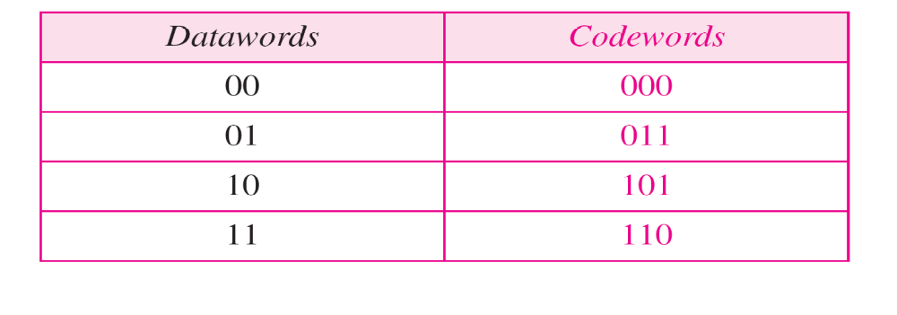
BLOCK CODING - Error detection
Example 10.2
Table 10.1 A code for error detection (Example 10.2)
Let us assume that k = 2 and n = 3. Table 10.1 shows the list of datawords and codewords. Later, we will see how to derive a codeword from a dataword.
Assume the sender encodes the dataword 01 as 011 and
sends it to the receiver. Consider the following cases:
1. The receiver receives 011. It is a valid codeword. The
receiver extracts the dataword 01 from it.

Slide 20
BLOCK CODING - Error detection
Example 10.2 (continued)
2. The codeword is corrupted during transmission, and
111 is received. This is not a valid codeword and is
discarded.
3. The codeword is corrupted during transmission, and
000 is received. This is a valid codeword. The receiver
incorrectly extracts the dataword 00. Two corrupted
bits have made the error undetectable.
Table 10.1 A code for error detection (Example 10.2)

Slide 21
BLOCK CODING - Error detection
Table 10.1 A code for error detection (Example 10.2)

Slide 22
BLOCK CODING - Error detection
Note
An error-detecting code can detect
only the types of errors for which it is designed; other types of errors may remain undetected.

Slide 23

BLOCK CODING - Error Correction
In error correction, the receiver needs to find (or guess) the original codeword sent.
We need more redundant bits for error correction than for error detection.
Figure 10.7 Structure of encoder and decoder in error correction

Slide 24
BLOCK CODING - Error Correction
Example 10.3
Let us add more redundant bits to Example 10.2 to see if the receiver can correct an error without knowing what was actually sent. We add 3 redundant bits to the 2-bit dataword to make 5-bit codewords. Table 10.2 shows the datawords and codewords. Assume the dataword is 01. The sender creates the codeword 01011. The codeword is corrupted during transmission, and 01001 is received. First, the receiver finds that the received codeword is not in the table. This means an error has occurred. The receiver, assuming that there is only 1 bit corrupted, uses the following strategy to guess the correct dataword.

Slide 25

BLOCK CODING - Error Correction
Example 10.3 (continued)
1. Comparing the received codeword with the first codeword in the table (01001 versus 00000), the receiver decides that the first codeword is not the one that was sent because there are two different bits.
2. By the same reasoning, the original codeword cannot be the third or fourth one in the table.
3. The original codeword must be the second one in the table because this is the only one that differs from the received codeword by 1 bit. The receiver replaces 01001 with 01011 and consults the table to find the dataword 01.
Table 10.2 A code for error correction (Example 10.3)

Slide 26
BLOCK CODING - Error Correction
Table 10.2 A code for error correction (Example 10.3)

Slide 27
BLOCK CODING - Hamming Distance
Hamming distance between two words (of the same size) is the number of difference between the corresponding bits.
  We show the Hamming distance between two words x and y as d(x,y)
  The Hamming distance can easily be found if we apply the XOR operation ( )on the two words and count the number of 1_{s} in the result.

Slide 28

BLOCK CODING - Error Correction
Example 10.4
Let us find the Hamming distance between two pairs of words.
1. The Hamming distance d(000, 011) is 2 because
2. The Hamming distance d(10101, 11110) is 3 because

Slide 29
BLOCK CODING - Minimum Hamming Distance
The minimum Hamming distance is the smallest Hamming distance between
all possible pairs in a set of words.
  We use d_{min} to define the minimum Hamming distance in a coding scheme.

Slide 30
BLOCK CODING - Minimum Hamming Distance
Example 10.5
Find the minimum Hamming distance of the coding scheme in Table 10.1.
Solution
We first find all Hamming distances.
The d_{min} in this case is 2.
Table 10.1 A code for error detection (Example 10.2)

Slide 31
BLOCK CODING - Minimum Hamming Distance
Example 10.6
Find the minimum Hamming distance of the coding scheme in Table 10.2.
Solution
We first find all the Hamming distances.
The d_{min} in this case is 3.
Table 10.2 A code for error correction (Example 10.3)

Slide 32
BLOCK CODING - Hamming Distance
Three parameters
  A coding scheme C is written as C(n,k) with a separate expression for d_{min} .
  For example, we can call our first coding scheme c(3,2) with d_{min} =2 and our second coding scheme c(5,2) with d_{min} =3.
Hamming distance and Error
  The Hamming distance between the received cordword and the sent codeword is the number of bits that are corrupted during transmission.
  For example : 3 bits are in error and the hamming distance between the two is d(00000, 01101) = 3

Slide 33
BLOCK CODING - Minimum Distance for error detection
To guarantee the detection of up to s errors in all cases, the minimum Hamming distance in a block
code must be d_{min} = s + 1.
  so that the received codeword does not match a valid codeword.

Slide 34
BLOCK CODING - Minimum Distance for error detection
Example 10.7
The minimum Hamming distance for our first code scheme (Table 10.1) is 2. This code guarantees detection of only a single error. For example, if the third codeword (101) is sent and one error occurs, the received codeword does not match any valid codeword. If two errors occur, however, the received codeword may match a valid codeword and the errors are not detected.
one error : 101 → 100 (does not match any valid code)
Two errors : 101 → 000 (errors are not detected)
Table 10.1 A code for error detection (Example 10.2)

Slide 35
BLOCK CODING - Minimum Distance for error detection
Example 10.8
Our second block code scheme (Table 10.2) has d_{min} = 3. This code can detect up to two errors. Again, we see that when any of the valid codewords is sent, two errors create a codeword which is not in the table of valid codewords. The receiver cannot be fooled.
However, some combinations of three errors change a valid codeword to another valid codeword. The receiver accepts the received codeword and the errors are undetected.
Table 10.2 A code for error correction (Example 10.3)

Slide 36

BLOCK CODING - Minimum Distance for error detection
Figure 10.8 Geometric concept for finding d_{min} in error detection

Slide 37

BLOCK CODING - Minimum Distance for Error Correction
Figure 10.9 Geometric concept for finding d_{min} in error correction

Slide 38
BLOCK CODING - Minimum Distance for Error Correction
Note
To guarantee correction of up to t errors in all cases, the minimum Hamming distance in a block code
must be d_{min} = 2t + 1.

Slide 39
BLOCK CODING - Minimum Distance for Error Correction
Example 10.9
A code scheme has a Hamming distance d_{min} = 4. What is the error detection and correction capability of this scheme?
Solution
This code guarantees the detection of up to three errors
(s = 3), but it can correct up to one error. In other words,
if this code is used for error correction, part of its capability is wasted. Error correction codes need to have an odd minimum distance (3, 5, 7, . . . ).

Slide 40
10.3 LINEAR BLOCK CODES
Almost all block codes used today belong to a subset called linear block codes. A linear block code is a code in which the exclusive OR (addition modulo-2) of two valid codewords creates another valid codeword.
Topics discussed in this section:
Minimum Distance for Linear Block Codes
Some Linear Block Codes

Slide 41
Linear Block Codes
Example 10.10
Let us see if the two codes we defined in Table 10.1 and Table 10.2 belong to the class of linear block codes.
1. The scheme in Table 10.1 is a linear block code
because the result of XORing any codeword with any
other codeword is a valid codeword. For example, the
XORing of the second and third codewords creates the
fourth one.
2. The scheme in Table 10.2 is also a linear block code.
We can create all four codewords by XORing two
other codewords.
Table10.1
Table10.2

Slide 42
Minimum Distance for Linear Block Codes
The minimum Hamming distance is the number of 1s in the nonzero valid codeword with the smallest number of 1s.

Slide 43
Minimum Distance for Linear Block Codes
Example 10.11
In our first code (Table 10.1), the numbers of 1s in the nonzero codewords are 2, 2, and 2. So the minimum Hamming distance is d_{min} = 2. In our second code (Table 10.2), the numbers of 1s in the nonzero codewords are 3, 3, and 4. So in this code we have d_{min} = 3.
Table10.1
Table10.2

Slide 44
Linear Block Codes-Simple parity-Check Code
In Simple parity-check code, a k-bit dataword is changed to an n-bit codeword where n=k+1.
The extra bit, called the parity bit, is selected to make the total number of 1s in the codeword even or odd.
This code is a single-bit error-detecting code; it cannot correct any error.
A simple parity-check code is a
single-bit error-detecting
code in which
n = k + 1 with d_{min} = 2.

Slide 45
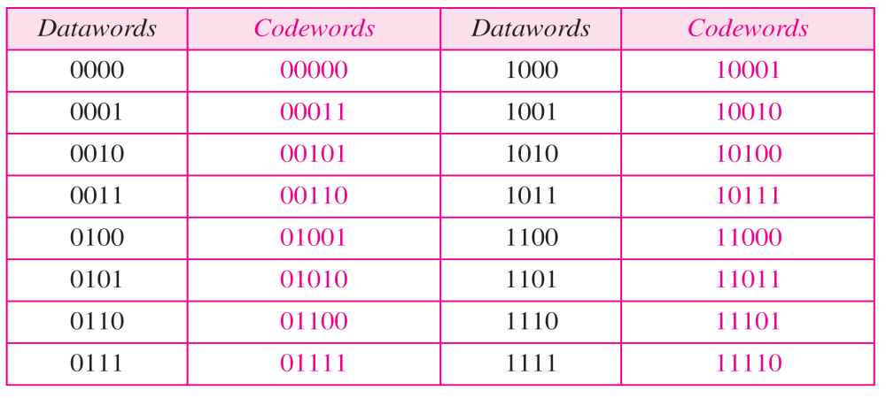
Minimum Distance for Linear Block Codes
Table 10.3 Simple parity-check code C(5, 4)

Slide 46

Minimum Distance for Linear Block Codes
Figure 10.10 Encoder and decoder for simple parity-check code

Slide 47
Minimum Distance for Linear Block Codes
Example 10.12
Let us look at some transmission scenarios. Assume the sender sends the dataword 1011. The codeword created from this dataword is 10111, which is sent to the receiver. We examine five cases:
1. No error occurs; the received codeword is 10111. The
syndrome is 0. The dataword 1011 is created.
2. One single-bit error changes a₁ . The received
codeword is 10011. The syndrome is 1. No dataword
is created.
3. One single-bit error changes r₀ . The received codeword
is 10110. The syndrome is 1. No dataword is created.

Slide 48
Minimum Distance for Linear Block Codes
Example 10.12 (continued)
4. An error changes r₀ and a second error changes a₃ .
The received codeword is 00110. The syndrome is 0.
The dataword 0011 is created at the receiver. Note that
here the dataword is wrongly created due to the
syndrome value.
5. Three bits—a₃, a₂, and a₁—are changed by errors.
The received codeword is 01011. The syndrome is 1.
The dataword is not created. This shows that the simple
parity check, guaranteed to detect one single error, can
also find any odd number of errors.

Slide 49
Note
A simple parity-check code can detect an odd number of errors.

Slide 50
LINEAR BLOCK CODES - Two-dimensional parity Check Code
In Two-dimensional parity-check code, the data code is organized in a table (rows and columns).
  In fig.10.11, the data to be sent, five 7bit bytes, are put in separate rows.
  For each row and each column, 1 parity-check bit is calculated.
  The whole table is then sent to the receiver, which finds the syndrome for each row and each column.
  As Fig.10.11 shows, the two-dimensional parity check can detect up to three errors that occur anywhere in the table.

Slide 51

LINEAR BLOCK CODES - Two-dimensional parity Check Code
Figure 10.11 Two-dimensional parity-check code

Slide 52

LINEAR BLOCK CODES - Two-dimensional parity Check Code
Figure 10.11 Two-dimensional parity-check code

Slide 53

LINEAR BLOCK CODES - Two-dimensional parity Check Code
Figure 10.11 Two-dimensional parity-check code

Slide 54
LINEAR BLOCK CODES - Hamming Codes
Hamming Codes were originally designed with d_{min} =3, which means that can detect up to two errors or correct one single error.
  We need to choose an integer m≥3.
  The value of n and k are then calculated from m as n=2^{m} -1 and k = n - m.
  The number of check bits r = m.
All Hamming codes discussed in this book have d_{min} = 3.
The relationship between m and n in these codes is n = 2^{m} − 1.

Slide 55
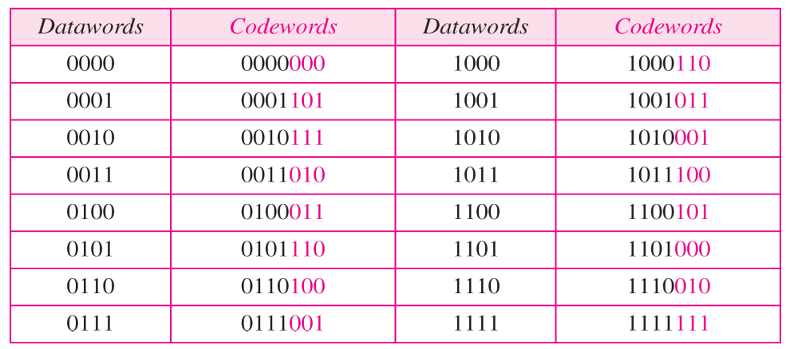
LINEAR BLOCK CODES - Hamming Codes
Table 10.4 Hamming code C(7, 4)

Slide 56

LINEAR BLOCK CODES - Hamming Codes
Figure 10.12 The structure of the encoder and decoder for a Hamming code

Slide 57
The calculation for a Hamming code
Generator creates 3 parity-check bit (r₀ ,r₁ , and r₂)
  r₀ = a₂ + a₁ + a₀ modulo-2
  r₁ = a₃+ a₂ + a₁ modulo-2
  r₂ = a₁ + a₀ + a₃ modulo-2
The checker in the decoder creates a 3bit syndrome bit
  s₀ = b₂ + b₁ + b₀ + q₀ modulo-2
  s₁ = b₃ + b₂ + b₁ + q₁ modulo-2
  s₂ = b₁ + b₀ + b₃ + q₂ modulo-2

Slide 58

LINEAR BLOCK CODES - Hamming Codes
Table 10.5 Logical decision made by the correction logic analyzer
In the cases unshaded in Table 10.5 ;
1 of the bits must be flipped (changed 0 to 1, or 1 to 0) to find the correct dataword.
  If syndrome value is 011 : b₂ bit must be changed 1 to 0,
    or 0 to 1
  If syndrome value is 010 : the generator is not concerned, because there is either no error or an error in the parity bit.

Slide 59
LINEAR BLOCK CODES - Hamming Codes
Example 10.13
Let us trace the path of three datawords from the sender to the destination:
1. The dataword 0100 becomes the codeword 0100011.
The codeword 0100011 is received. The syndrome is
000, the final dataword is 0100.
2. The dataword 0111 becomes the codeword 0111001.
The syndrome is 011. After flipping b₂ (changing the 1
to 0), the final dataword is 0111.
3. The dataword 1101 becomes the codeword 1101000.
The syndrome is 101. After flipping b₀, we get 0000,
the wrong dataword. This shows that our code cannot
correct two errors.
0

Slide 60
LINEAR BLOCK CODES - Hamming Codes
Example 10.14
We need a dataword of at least 7 bits. Calculate values of k and n that satisfy this requirement.
Solution
We need to make k = n − m greater than or equal to 7,
or 2^{m} − 1 − m ≥ 7.
1. If we set m = 3, the result is n = 2³ − 1 and k = 7 − 3,
or 4, which is not acceptable.
2. If we set m = 4, then n = 2⁴ − 1 = 15 and k = 15 − 4 =
11, which satisfies the condition. So the code is
C(15, 11)

Slide 61
Burst error correction using LINEAR BLOCK Hamming code
A hamming code can only correct a single error or detect a double error.
However, there is a way to make it correct a burst error.
  The key is to split a burst error between several codewords, one error for each code.

Slide 62

Burst error correction using LINEAR BLOCK Hamming code
Figure 10.13 Burst error correction using Hamming code

Slide 63
10.4 CYCLIC CODES
Cyclic codes are special linear block codes with one extra property. In a cyclic code, if a codeword is cyclically shifted (rotated), the result is another codeword.
Topics discussed in this section:
Cyclic Redundancy Check
Hardware Implementation
Polynomials
Cyclic Code Analysis
Advantages of Cyclic Codes
Other Cyclic Codes

Slide 64
Cyclic Redundancy Check
In a Cyclic Code, if a codeword is cyclically shifted , the result is another codeword.
  For example, if 1011000 is a codeword and we cyclically left-shift, then 0110001 is also a codeword.
  b₁ = a₀, b₂ = a₁, b₃ = a₂, b₄ = a₃, b₅ = a₄, b₆ = a₅, b₀ = a₆
  In the right most equation, the last bit of the first word is wrapped around and becomes the first bit of the second word.
Cyclic Redundancy Check (CRC) is used in networks such as LANs and WANs.

Slide 65

Cyclic Redundancy Check
Table 10.6 A CRC code with C(7, 4)

Slide 66
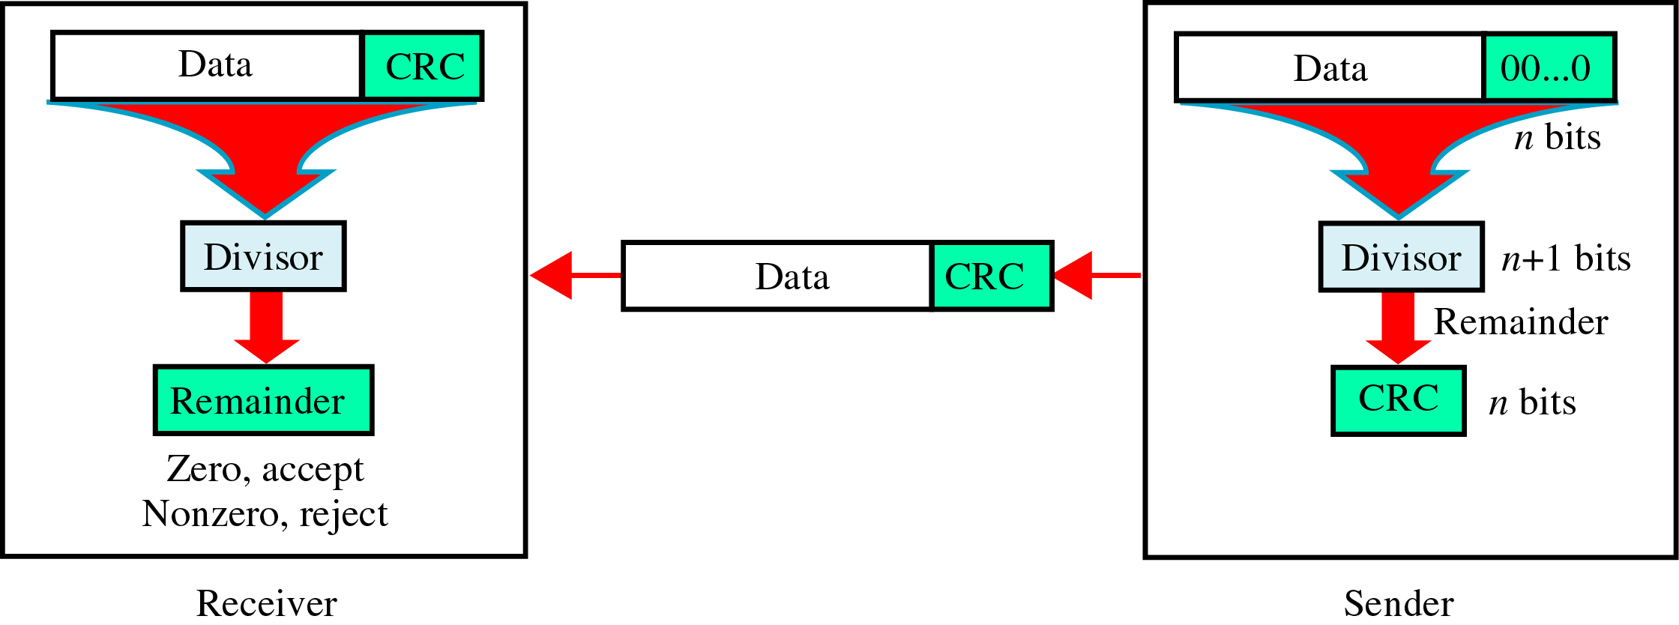
Cyclic Redundancy Check
CRC(Cyclic Redundancy Check)
~ is based on binary division.
○ CRC must have 2 qualities
- It must have exactly one less
bit than the divisor
- Resulting bit sequence (Data+CRC)
exactly divisible by the divisor.

Slide 67

Cyclic Redundancy Check
Figure 10.14 CRC encoder and decoder

Slide 68

Cyclic Redundancy Check
Figure 10.15 Division in CRC encoder

Slide 69

Cyclic Redundancy Check
Figure 10.16 Division in the CRC decoder for two cases

Slide 70

Cyclic Redundancy Check
Figure 10.21 A polynomial to represent a binary word

Slide 71

Cyclic Redundancy Check
Figure 10.22 CRC division using polynomials

Slide 72
Cyclic Redundancy Check
Note
The divisor in a cyclic code is normally called the generator polynomial
or simply the generator.

Slide 73
Cyclic Redundancy Check
Note
In a cyclic code,
If s(x) ≠ 0, one or more bits is corrupted.
If s(x) = 0, either
a. No bit is corrupted. or
b. Some bits are corrupted, but the
decoder failed to detect them.
* S(X) = Syndrome

Slide 74
Cyclic Redundancy Check
Note
In a cyclic code, those e(x) errors that are divisible by g(x) are not caught.
  Received Code word = transmitted Code word + Error
    {Received Code word = C(X) + e(X)} / g(X)

Slide 75
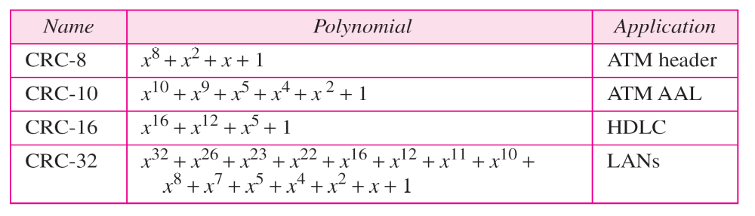
Cyclic Redundancy Check
Table 10.7 Standard polynomials

Slide 76
Cyclic Code
Advantages of Cyclic Codes
  Cyclic codes have a very good performance in detecting single-bit errors, double errors, an odd number of errors, and burst errors.
  They can easily be implemented in hardware and software.
  They are especially fast when implemented in hardware.
  This has cyclic codes a good candidate for many networks.

Slide 77
10.5 CHECKSUM
The last error detection method we discuss here is called the checksum. The checksum is used in the Internet by several protocols although not at the data link layer. However, we briefly discuss it here to complete our discussion on error checking
Topics discussed in this section:
Idea
One’s Complement
Internet Checksum

Slide 78
Checksum
Like linear and cyclic codes, the checksum is based on the concept of redundancy.
Several protocols still use the checksum for error correction, although the tendency is to replace it with a CRC.

Slide 79
Idea - Checksum
Example 10.18
Suppose our data is a list of five 4-bit numbers that we want to send to a destination. In addition to sending these numbers, we send the sum of the numbers. For example, if the set of numbers is (7, 11, 12, 0, 6), we send (7, 11, 12, 0, 6, 36), where 36 is the sum of the original numbers. The receiver adds the five numbers and compares the result with the sum. If the two are the same, the receiver assumes no error, accepts the five numbers, and discards the sum. Otherwise, there is an error somewhere and the data are not accepted.

Slide 80
Idea - Checksum
Example 10.19
We can make the job of the receiver easier if we send the negative (complement) of the sum, called the checksum. In this case, we send (7, 11, 12, 0, 6, −36). The receiver can add all the numbers received (including the checksum). If the result is 0, it assumes no error; otherwise, there is an error.

Slide 81
One’s Complement - Checksum
In one’s Complement arithmetic, We can represent unsigned numbers between 0 and 2^{n} -1 using only n bits.
  If the number has more than n bits, the extra left most bits need to be added to the n rightmost bits (wrapping).
  A negative number can be represented by inverting all bits (changing a 0 to a 1 and a 1 to a 0).
    This is the same as subtracting the number from 2^{n} -1.

Slide 82
One’s Complement - Checksum
Example 10.20
How can we represent the number 21 in one’s complement arithmetic using only four bits?
Solution
The number 21 in binary is 10101 (it needs five bits). We can wrap the leftmost bit and add it to the four rightmost bits. We have (0101 + 1) = 0110 or 6.

Slide 83
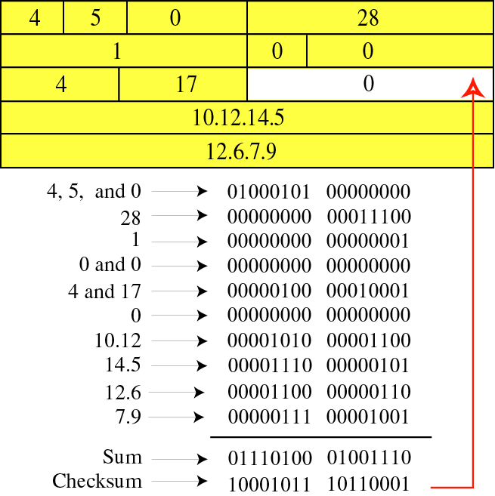
Detection

Slide 84
Detection(cont’d)
예제 7 ( at a sender)
16비트 블록이 8비트의 검사 합을 사용하여 보내진다고 가정
Original data : 10101001 00111001
1의 보수연산을 사용해서 수를 더한다.
10101001
00111001
--------------
11100010 Sum
00011101 Checksum
이 비트 형식이 보내진다.
10101001 00111001 00011101 ← 전송

Slide 85
Detection(cont’d)
예제 8 ( at a receiver)
수신자가 예제7에서 보낸 16비트 블록을 받았고, 오류는 없다고 가정하면
Received data : 10101001 00111001 00011101
수신자는 3개의 패턴을 더한 후, 모두 1인 결과를 얻는다
10101001
00111001
00011101
---------------
11111111 ← Sum
보수화하면, 모두 0이 되어 오류가 없음을 보여준다.
00000000 ← Complement : 패턴이 OK 라는 의미

Slide 86
예제
Now suppose there is a burst error of length 5 that affects 4 bits.
10101111 11111001 00011101
When the receiver adds the three sections, it gets
1 ← carry from 8th column
10 ← carry from 6th column
1 ← carry from 5th column
10 ← carry from 4th column
1 ← carry from 3rd column
1 ← carry from 2nd column
1 ← carry from 1st column
10101111
11111001
00011101
Partial Sum 1 11000101
Carry 1
Sum 11000110
Complement 00111001 the pattern is corrupted.

Slide 87
One’s Complement
Example 10.21
How can we represent the number −6 in one’s complement arithmetic using only four bits?
Solution
In one’s complement arithmetic, the negative or complement of a number is found by inverting all bits. Positive 6 is 0110; negative 6 is 1001. If we consider only unsigned numbers, this is 9. In other words, the complement of 6 is 9. Another way to find the complement of a number in one’s complement arithmetic is to subtract the number from 2^{n} − 1 (16 − 1 in this case).

Slide 88
One’s Complement
Example 10.22
Let us redo Exercise 10.19 using one’s complement arithmetic. Figure 10.24 shows the process at the sender and at the receiver. The sender initializes the checksum to 0 and adds all data items and the checksum (the checksum is considered as one data item and is shown in color). The result is 36. However, 36 cannot be expressed in 4 bits. The extra two bits are wrapped and added with the sum to create the wrapped sum value 6. In the figure, we have shown the details in binary. The sum is then complemented, resulting in the checksum value 9 (15 − 6 = 9). The sender now sends six data items to the receiver including the checksum 9.

Slide 89
One’s Complement
Example 10.22 (continued)
The receiver follows the same procedure as the sender. It adds all data items (including the checksum); the result is 45. The sum is wrapped and becomes 15. The wrapped sum is complemented and becomes 0. Since the value of the checksum is 0, this means that the data is not corrupted. The receiver drops the checksum and keeps the other data items. If the checksum is not zero, the entire packet is dropped.

Slide 90
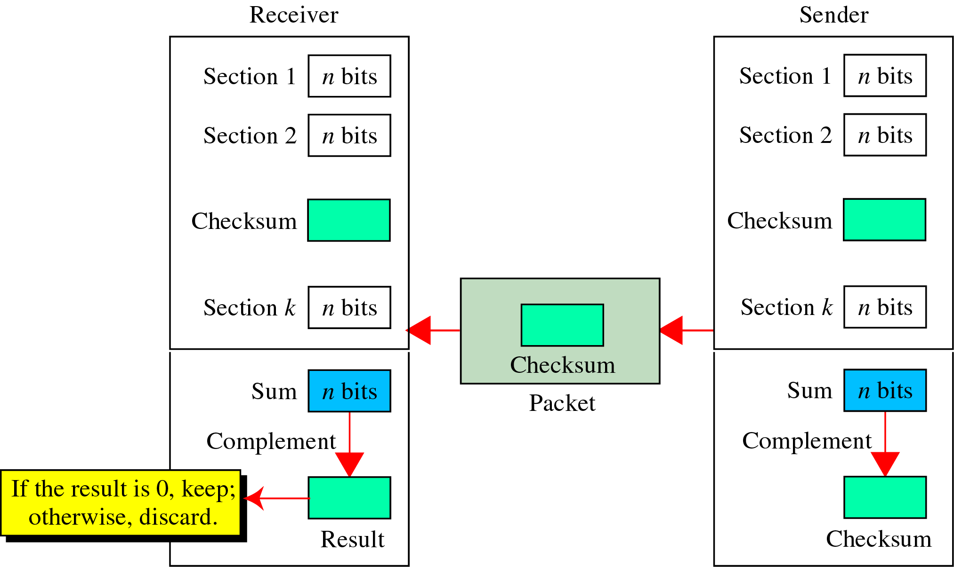
Internet Checksum
Checksum Generator

Slide 91
Internet Checksum
Note
Sender site:
1. The message is divided into 16-bit words.
2. The value of the checksum word is set to 0.
3. All words including the checksum are
added using one’s complement addition.
4. The sum is complemented and becomes the
checksum.
5. The checksum is sent with the data.

Slide 92
Internet Checksum
Note
Receiver site:
1. The message (including checksum) is
divided into 16-bit words.
2. All words are added using one’s
complement addition.
3. The sum is complemented and becomes the
new checksum.
4. If the value of checksum is 0, the message
is accepted; otherwise, it is rejected.

Slide 93

One’s Complement
Figure 10.24 Example 10.22

Slide 94

Q & A

